Slide 1
Network-Accelerator Co-Design for Dynamic Inference of Natural Language Processing
宋玉红
2020.08.16

Slide 2
Outline
Fine-tune for different sub-model(get correct result)
Block size=5, pruning number = 1,13,24
Block size = 10,pruning number = 1,99
Use high-precision timer to get computation time in different pruning sparsity ratio
Run reinforcement learning code
Confirm loss weight range

Slide 3
Experiment
block size = 5 pruning number = 1, 13, 24

Slide 4
Experiment
block size = 5 pruning number = 1, 13, 24

Slide 5
Experiment
block size = 10 pruning number = 1, 99

Slide 6
Experiment
block size = 10 pruning number = 1, 99

Slide 7
Experiment
block size = 10 pruning number = 1, 99

Slide 8
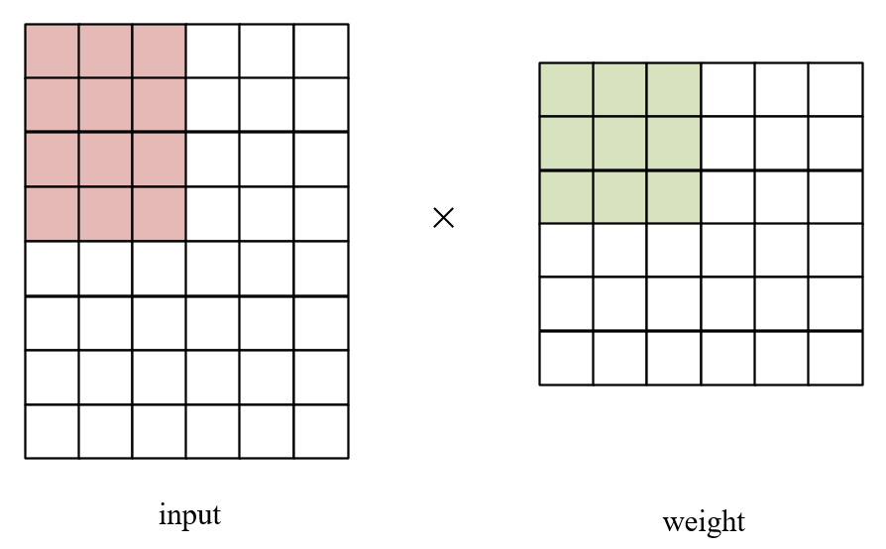
Experiment
Computation time
operation number = input row × weight row × weight column
operation number = input row × block size × block size × block number

Slide 9
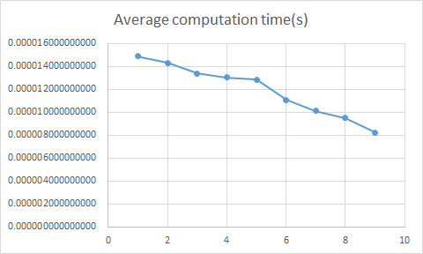
Experiment
Computation time (block size = 3)
（350×3）×（3×3）

Slide 10
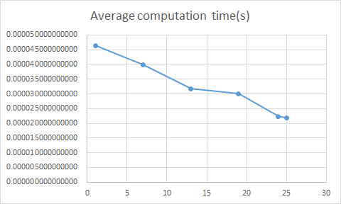
Experiment
Computation time (block size = 5)
（350×5）×（5×5）

Slide 11
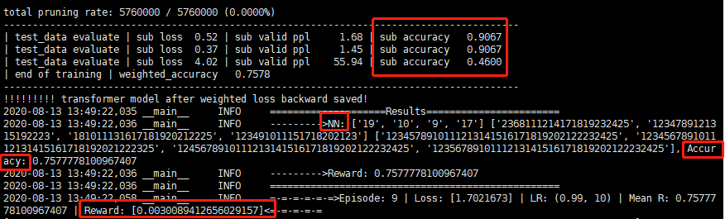
Experiment
Reinforcement learning
Weighted accuracy?

Slide 12
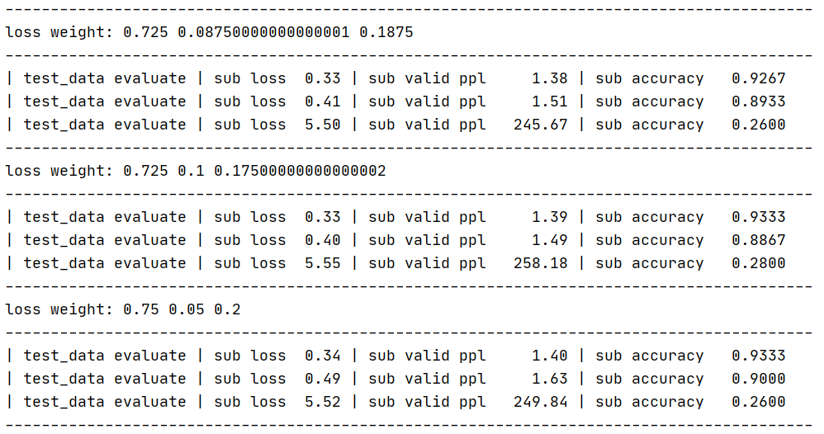
Experiment
Loss weight range
loss1:[0.7,0.8], loss2:[0.05,0.1]

Slide 13
Plan
Add pre-compression model
Shrink reinforcement learning search space
Confirm experiment process

